Slide 1
Predicting Workplace Cultural Values Rating

Slide 2
Description of Data Set
Full Training Dataset: 895,751 obs. of 117 variables
Full Testing Dataset: 99,528 obs. of 117 variables
After removing observations with response variable (Cultural Values) “NA,” the training and testing sets were 778,507 and 86,635 observations respectively.

Slide 3
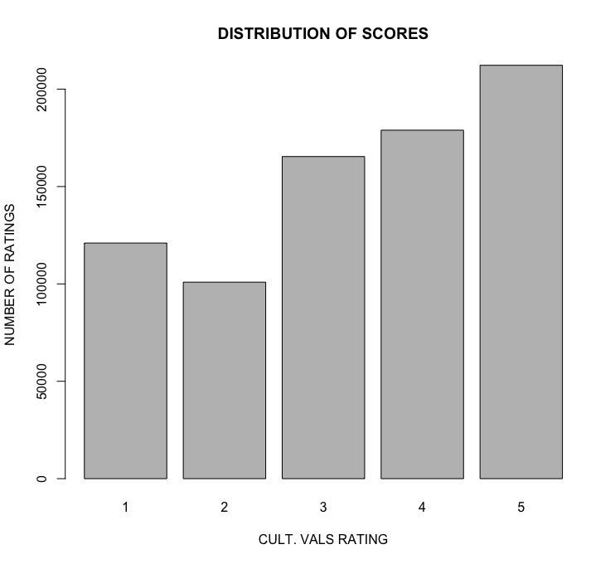

TRAINING DATA DISTRIBUTION
TESTING DATA DISTRIBUTION

Slide 4
Predictors
Dataset included 81 predictors processed form written responses labeled 0,1, and 2.
Respectively, these labels signal whether a given predictor was omitted entirely in written responses (0), talked about negatively (1), or talked about positively (2)
Group medians and means including 95% confidence interval plotted for each
Predictors were treated as factors

Slide 5
Plan for Prediction
Using these predictors, we fit multiple different classification models and measured both prediction accuracy and prediction adjacency accuracy (prediction within 1 score of the testing value).
Models fit on all predictors: ordinal logistic, LDA, random forest, and SVC.
Reduced models fit: 2 ordinal logistic models and decision tree.
Reduced formulas used:
as.factor(culture_values) ~ intensity.negative + illegal + religious.tolerance + ENGAGEMENT +speed + honesty + minority.friendly + connections + integrity + RESPECT + senior.leaders + EXECUTION + challenging.work + not.agist + disabled.friendly + job.security + intensity.positive + mission + voice.of.the.employee inclusivity.general
intensity.negative + illegal + religious.tolerance + ENGAGEMENT + speed + honesty + minority.friendly + connections + integrity + RESPECT + senior.leaders + EXECUTION + challenging.work + not.agist + disabled.friendly + job.security + intensity.positive + mission + voice.of.the.employee + inclusivity.general

Slide 6
Models
All models appear about the same in terms of both accuracy and interpretability
Classification tree has the worst performance, and full ordinal logistic the best
We chose to interpret the ordinal logistic model coefficients based on the high accuracy and interpretability
The following slides show a selection of predictors that appeared to explain much of the response result

Slide 7
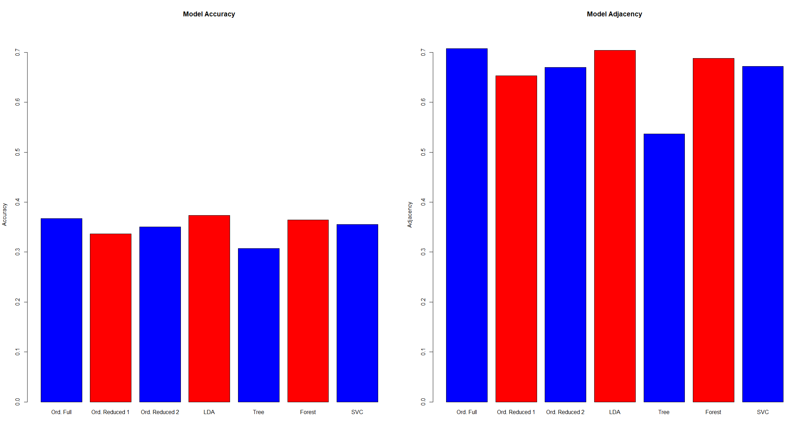
Accuracy Per Model

Slide 8
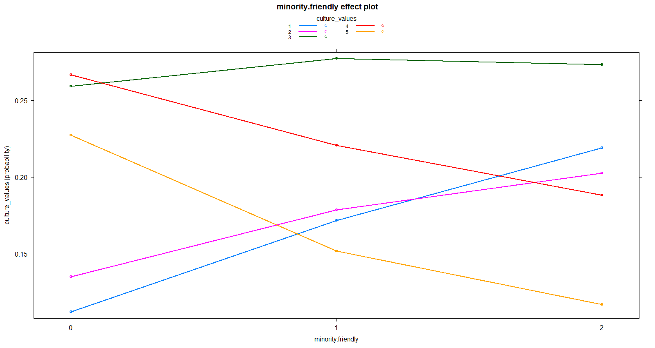

Slide 9
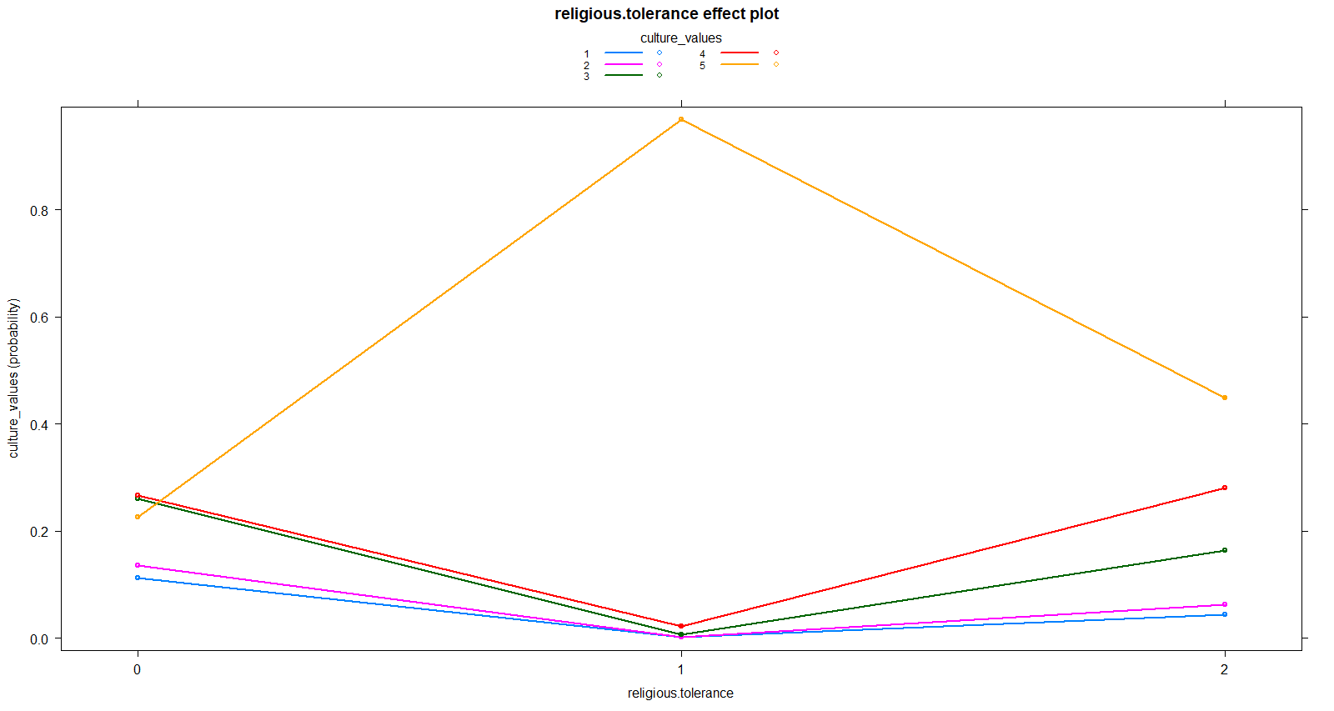

Slide 10
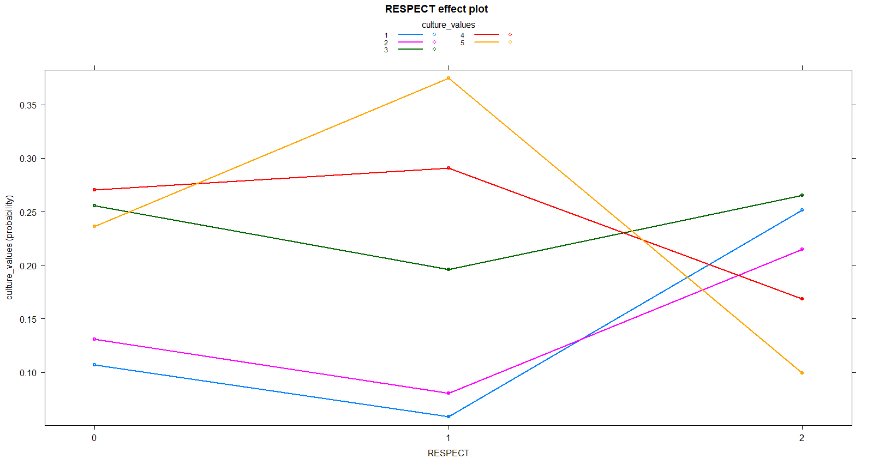

Slide 11
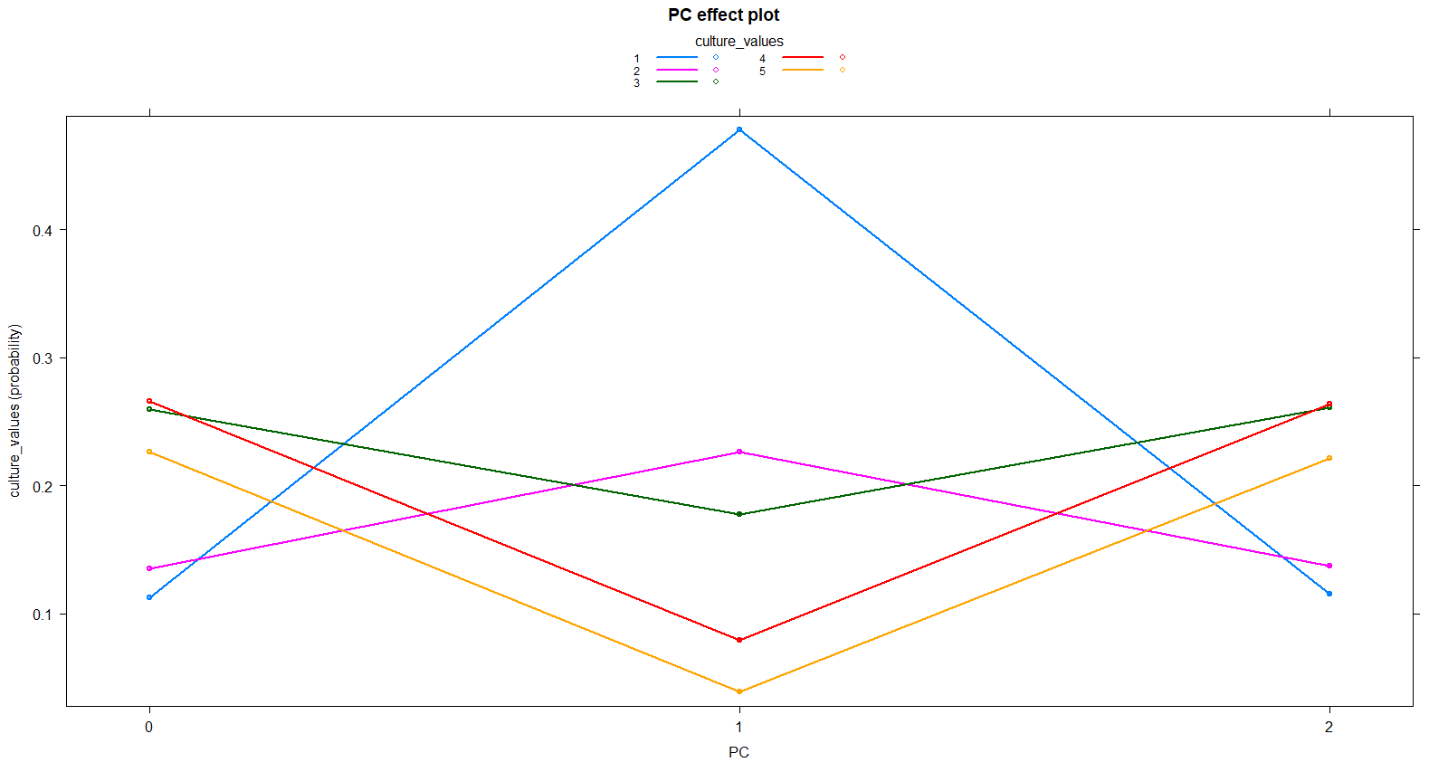

Slide 12
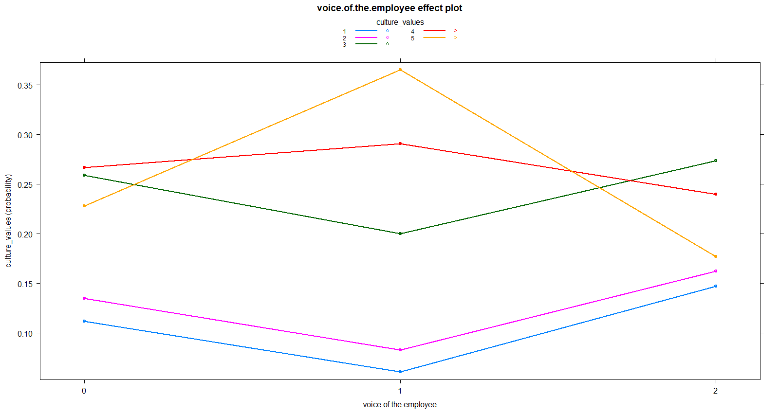

Slide 13
Conclusion & Analysis
Through the comparison of prediction accuracies and the specific predictor effect plots, it can be concluded that some of these predictors had greater impact on the cultural value rating.
Since the dataset (both testing and training) contained so many observations, the most efficient way to determine relevant predictors was by analyzing the coefficient estimates
The individual predictor effect plots show how the probability of each culture value rating changes depending on how the variable was talked about

Slide 14
Conclusion & Analysis
Through the 7 models fitted, the highest prediction accuracy on the testing dataset achieved was with the model fit through Linear Discriminant Analysis, but all models achieved ~35% prediction accuracy
Accuracy within 1 rating (adjacent accuracy) was also measured to further understand factors affect how workers view their workplace culture. The models achieved ~65% adjacent accuracy (decision tree which fell to ~50%)

Slide 15
Summary
The goal of this analysis was to further understand what factors influence workplace culture values
Understanding this can be impactful for managers and business owners who wish to create a more comfortable environment for their employees. Knowing which factors change employee opinion of workplace culture can change strategies and initiatives put in place in the office
* While prediction was the goal of this analysis, the more influential takeaways may come from the coefficient estimates of the models we created

